Slide 1
---
apiVersion: slide/v1
author:
-
affiliation: "IBM Center for Open Source Data and AI Technologies (CODAIT)"
name: "Romeo Kienzler"
role: "Data Scientist"
-
affiliation: "University Hospital Basel"
name: "Ivan Nesic"
role: "ML Engineer"
-
name: "The Elyra, JupyterLab, Kubernetes and KubeFlow authors"
kind: Titlepage
published:
-
type: video
url: "https://www.youtube.com/watch?v=H8WskMEUI74"
-
type: conference
url: "http://conference.scipy.org/proceedings/scipy2021/pdfs/ivan_nesic.pdf"
title:
- "CLAIMED – Component Library for AI, Machine Learning, ETL and Data Science"
- "A Kubeflow no code / low code architecture"

Slide 2
Requirements
- Rapid prototyping using visual editing and notebooks
- Seamless scaling during development and deployment
- GPU support
- ML tools: PyData stack, TensorFlow, PyTorch, …
- life science tools: DICOM input, DICOM output, …
- Reproducibility
- Data lineage
- Reference implementation in open source
- Collaboration support

Slide 3
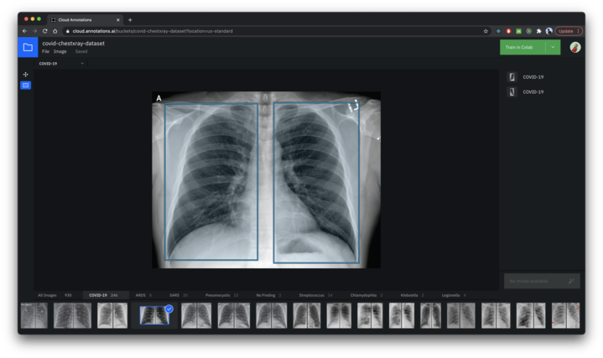

Cloud annotations provides...
Browser based
image labeling:
Classification /
Object recognition
training data
...in Open Source
<number>
<number>

Slide 4

Docker provides...
OS-level “virtualization” to deliver and run software in packages called containers
Lightweight “virtualization”
Security and isolation
Super-fast startup/teardown
...on top of Linux
<number>
<number>

Slide 5

Kubernetes provides...
Some prominent users: Adidas, Booking.com, Box, Google, Huawei, IBM, The New York Times, ING, ricardo.ch, Spotify, Wikimedia, Zalando
Container Orchestration
Deployment, scaling and management
High availability
...on top of Linux Clusters
<number>
<number>

Slide 6
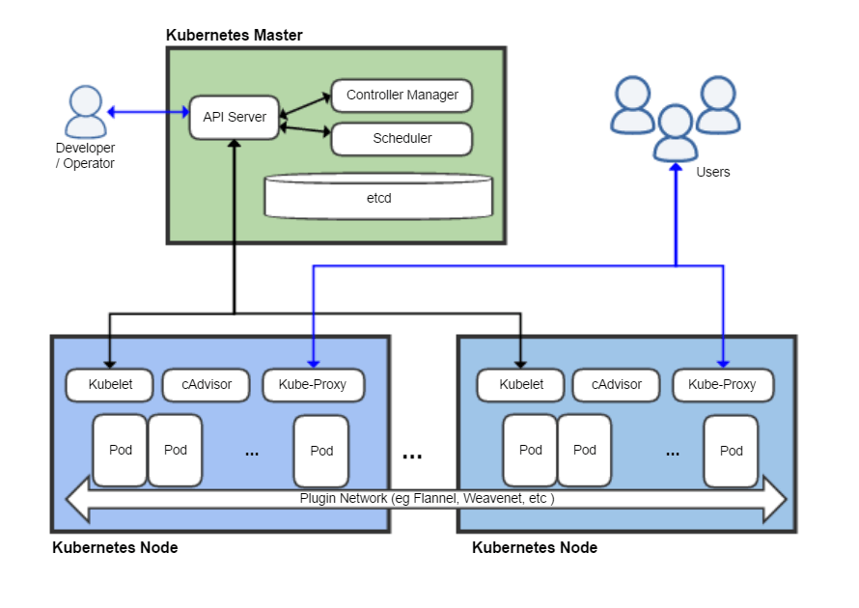
Kubernetes architecture...
<number>
<number>

Slide 7
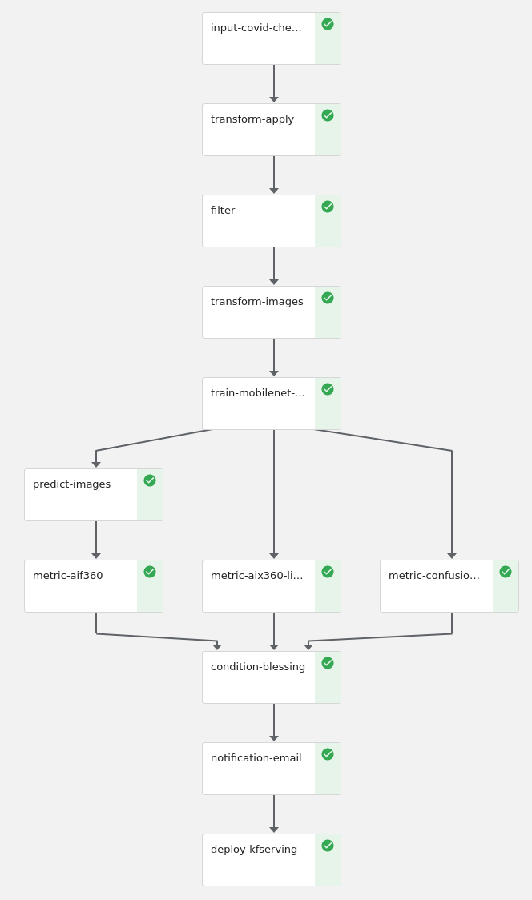

Kubeflow provides...
Some prominent users:
Amazon Web Services
IBM Watson Services
IBM’s top clients
AutoML, Deployment, Reproducibility
Notebooks, Pipelines, Serving, Training, Scale
...on top of Kubernetes
<number>
<number>

Slide 8
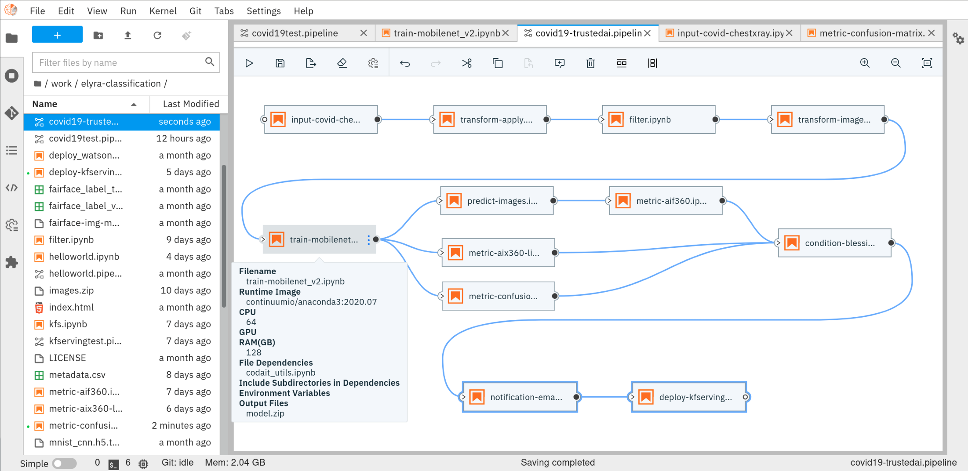

Elyra provides...
Some prominent users: Three IBM clients, one
Fortune 500 company
No Code / Low Code ML Pipeline Design
Re-usable pipeline components
Interchangeability of Engines
(Kubeflow, Airfow, ...)
...on top of JupyerLab, VSCode, ...
<number>
<number>

Slide 9
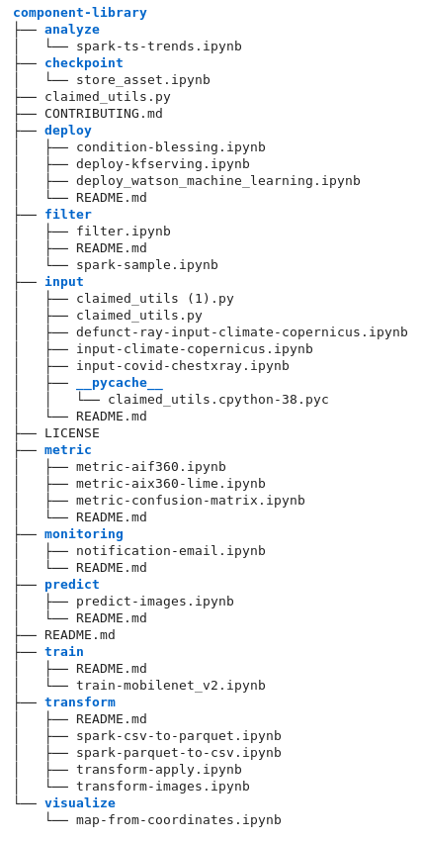
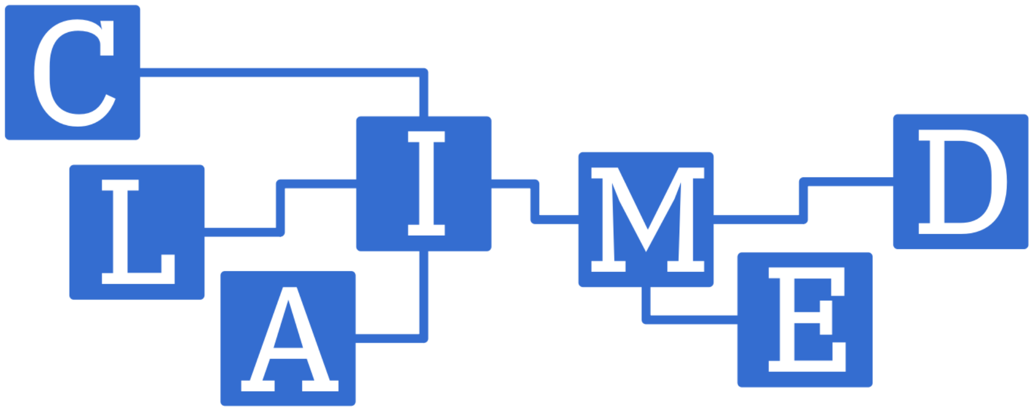
CLAIMED...
Current users: University Hospital Basel
Motion.AI
Component Library for AI,
Machine Learning, ETL and
Data Science
Portability
No Code / Low Code
Pipeline Components
Jupyter Notebooks
Sample Pipelines
...on top of Elyra and Kubeflow
<number>
<number>

Slide 10
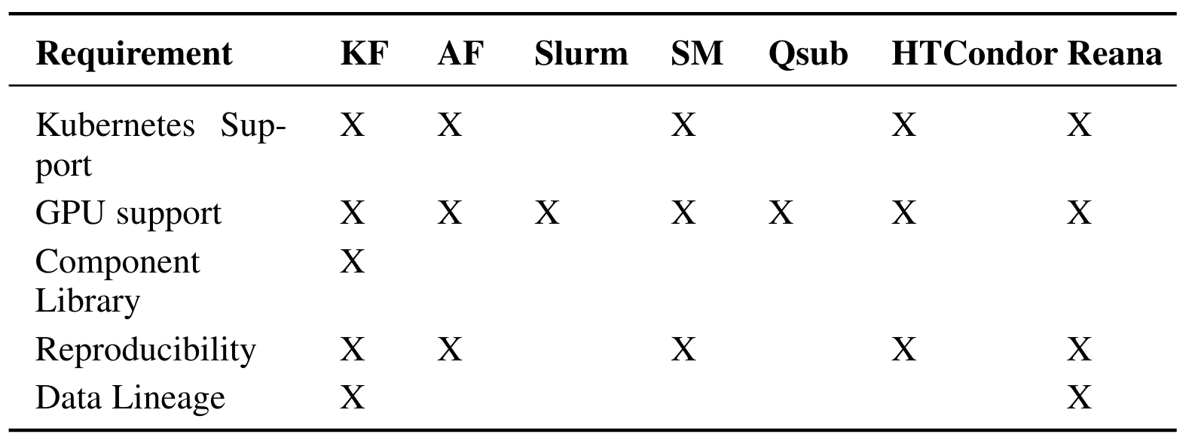
Other workflow managers..
vs. Kubeflow
<number>
<number>

Slide 11
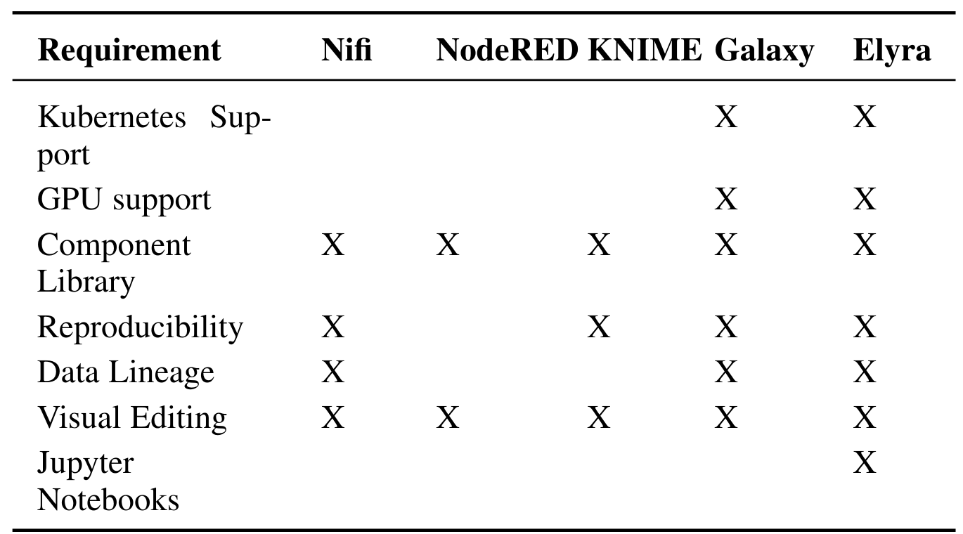
Other low code / no code tools..
vs. Elyra
<number>
<number>

Slide 12






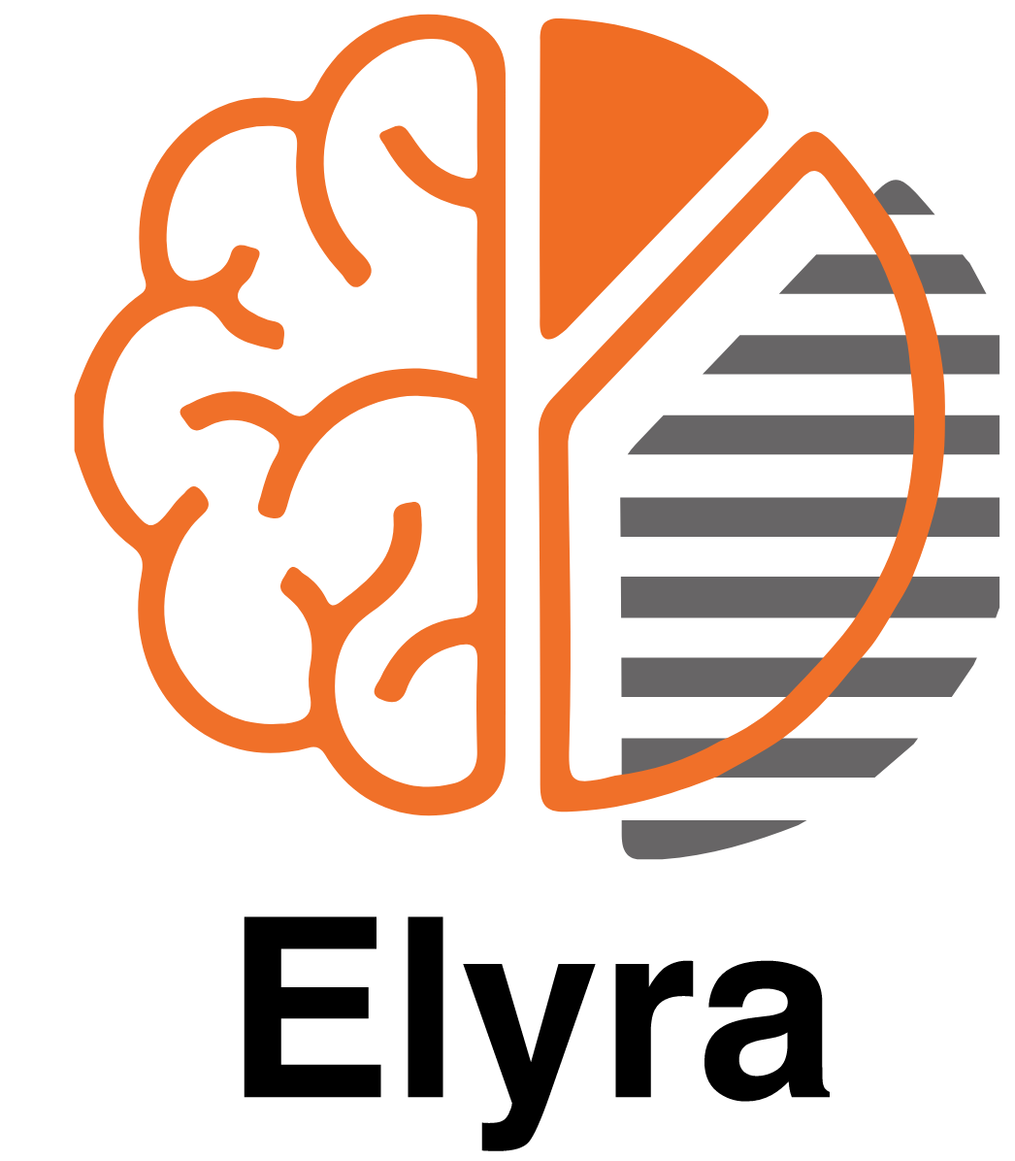

Full (source code) round-trip visual editing…
pull
*.r
[ref]
*.ipynb
*.py
*.sh
… and Kubeflow deployment using the Elyra Pipeline Editor
<number>
<number>

Slide 13
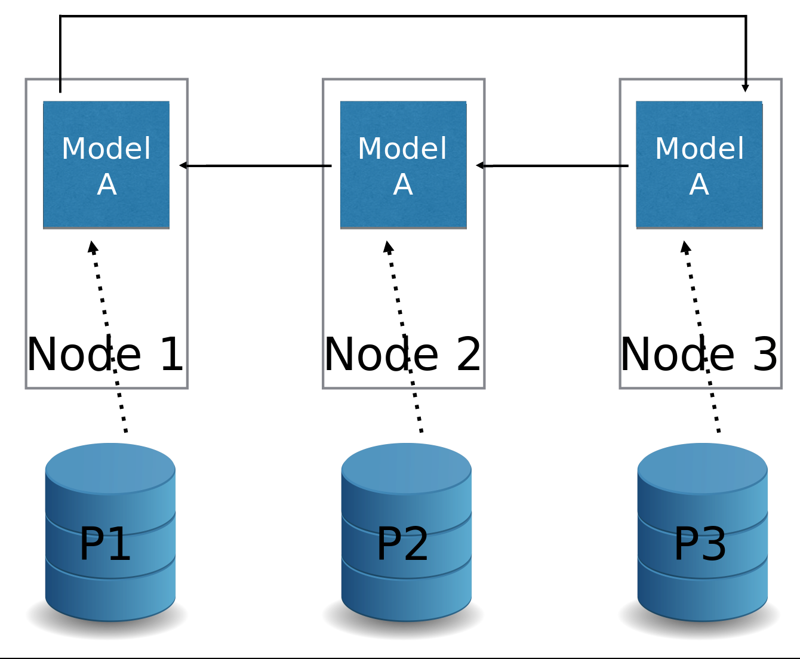
Example Pipeline Components Category: Training Group: Distributed Name: TFJob
The TFJob operator supports parallel training on multiple nodes and GPUs

Slide 14
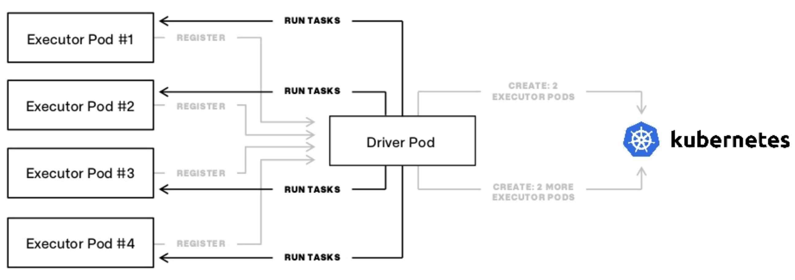
Example Pipeline Components Category: Processing Group: Distributed Name: SparkJob
The SparkJob operator supports parallel processing on multiple nodes

Slide 15
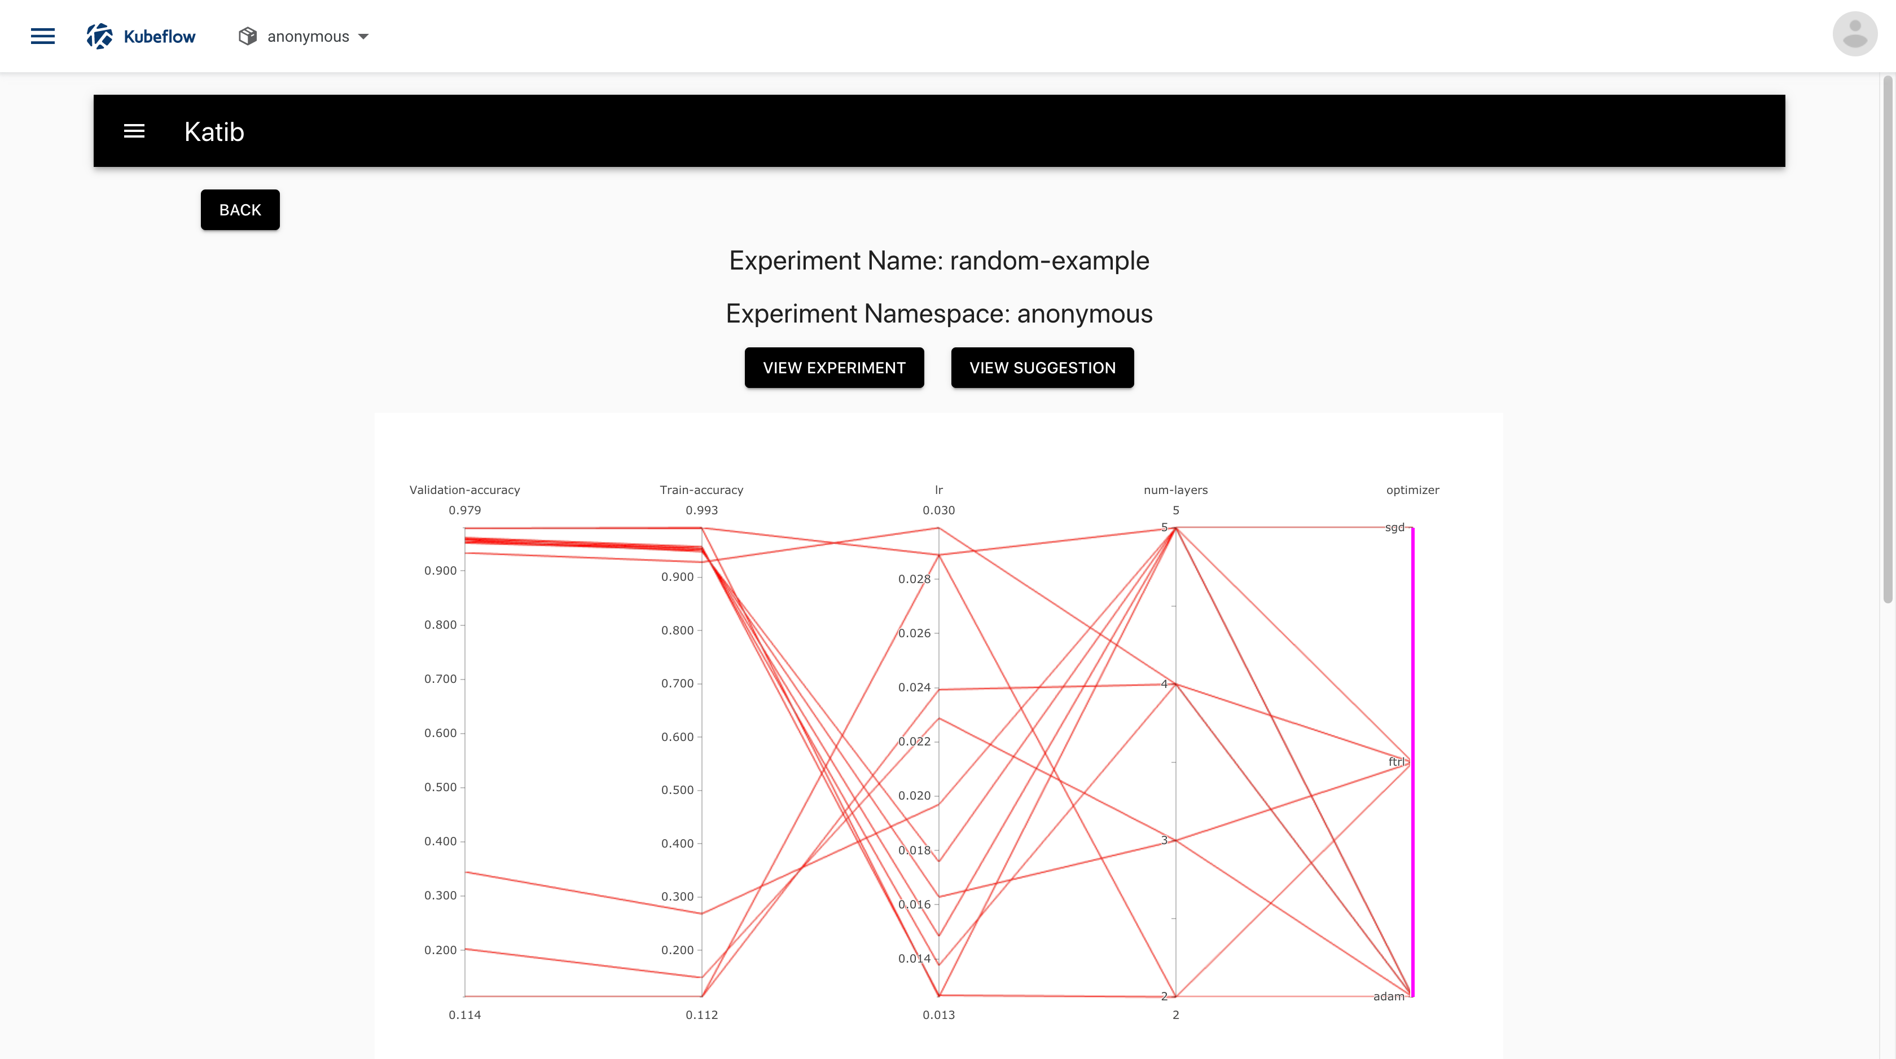
Example Pipeline Components Category: Tuning Group: Hyperopt Name: Katib
Visualization of a hyper parameter optimization result

Slide 16
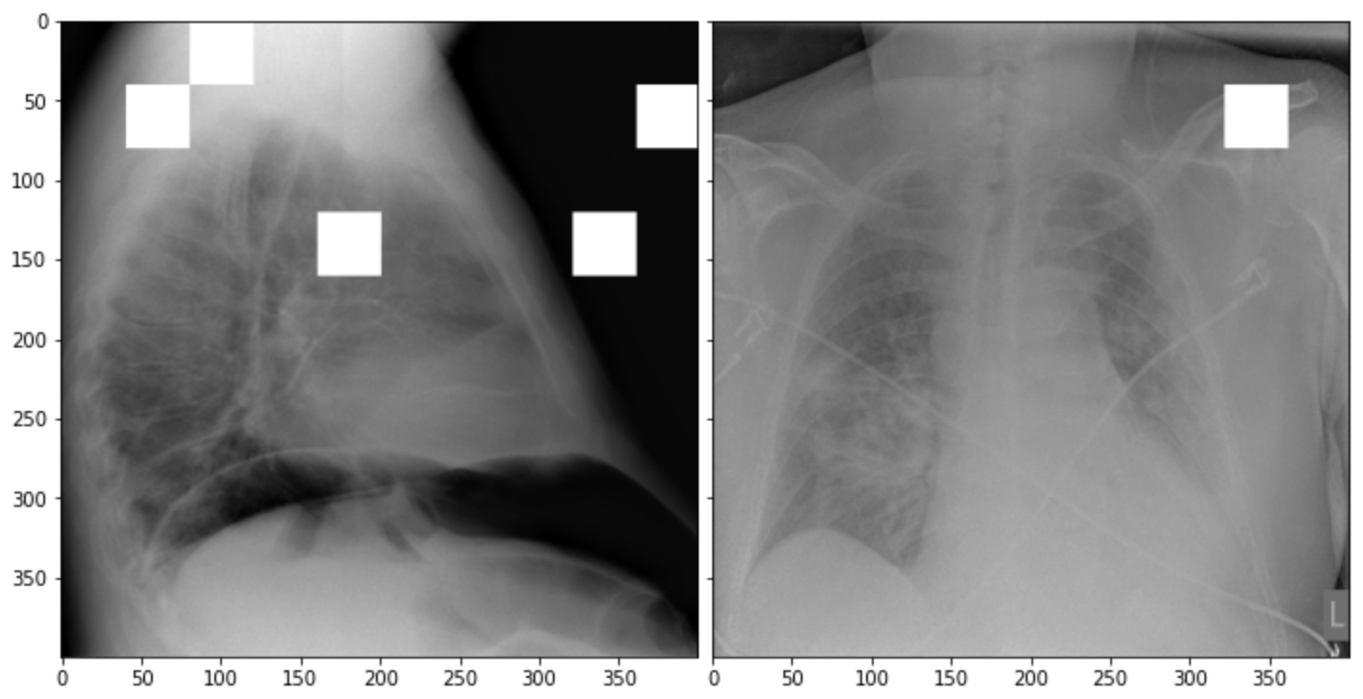
Example Pipeline Components Category: Metric Group: Explainability Name: AIX360/LIME
Example on how LIME helps to identify classification relevant areas of an image

Slide 17
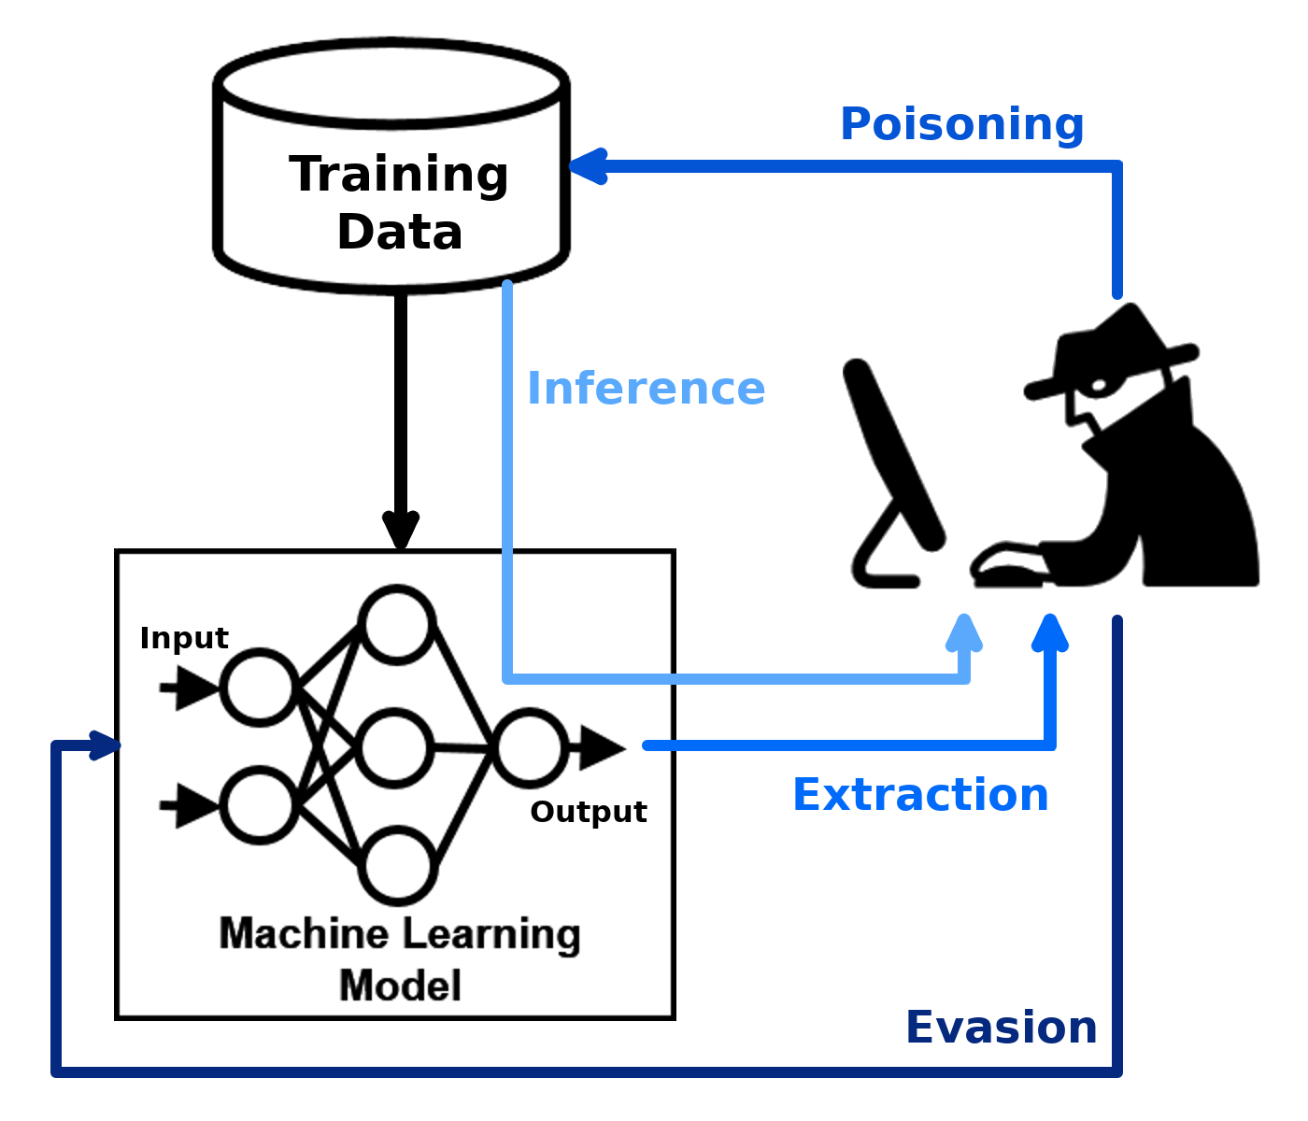
Example Pipeline Components Category: Metric Group: Adversarial Robustness Name: ART
Example on how Adversarial Attacks happen

Slide 18
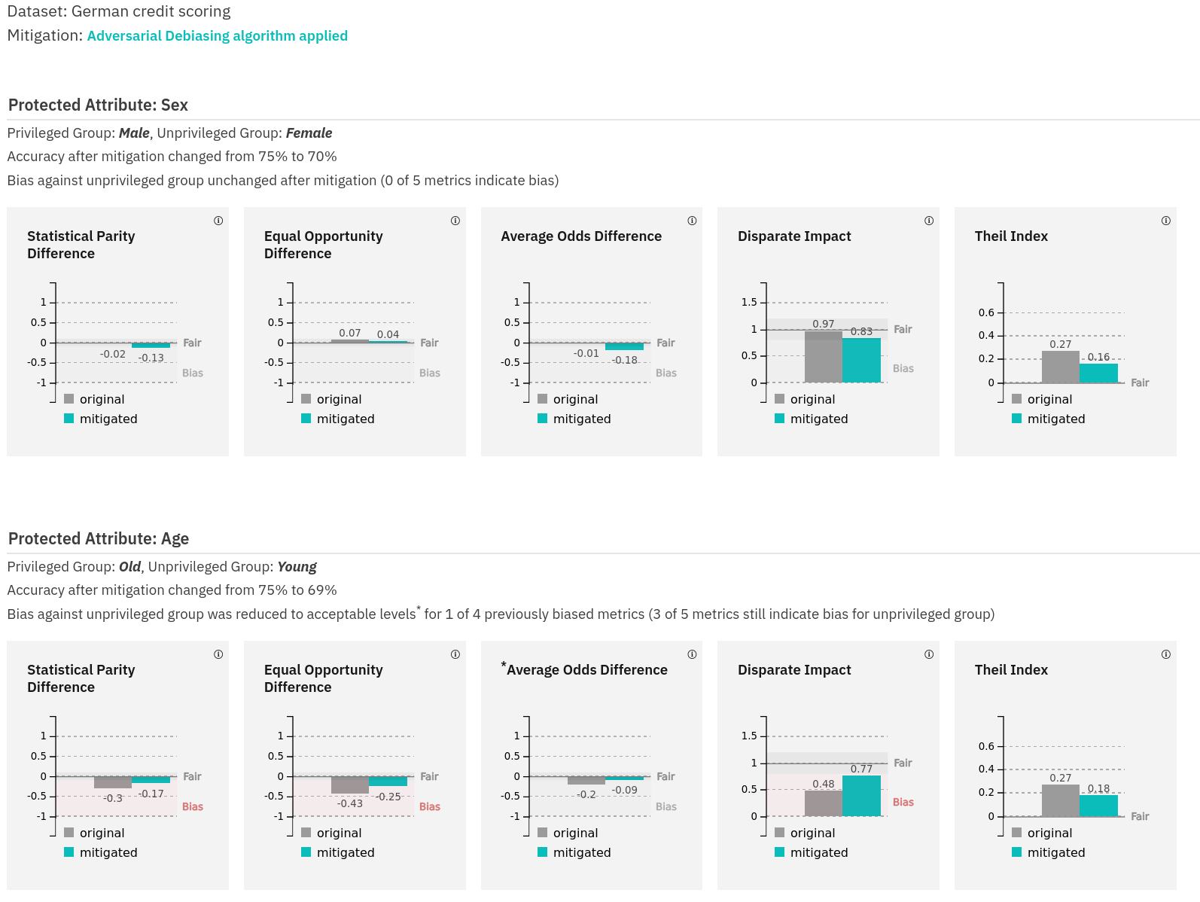
Example Pipeline Components Category: Metric Group: AI Fairness Name: AIF360
Example on how the AIF360 toolkit computes fairness metrics and mitigates bias

Slide 19
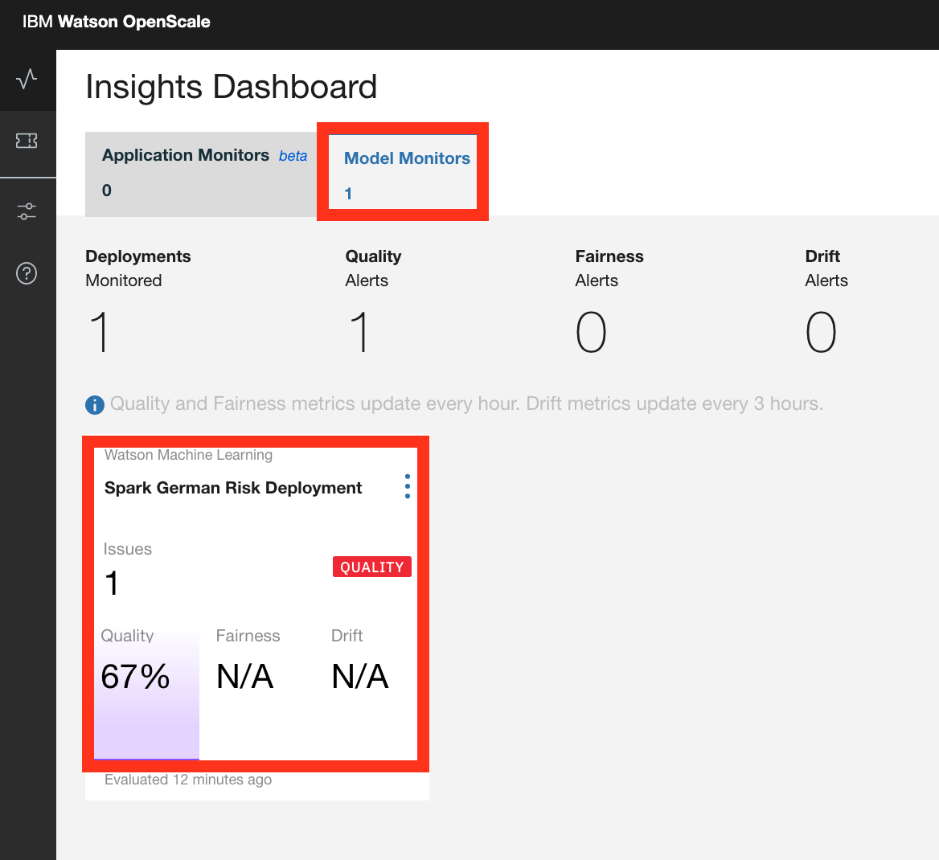
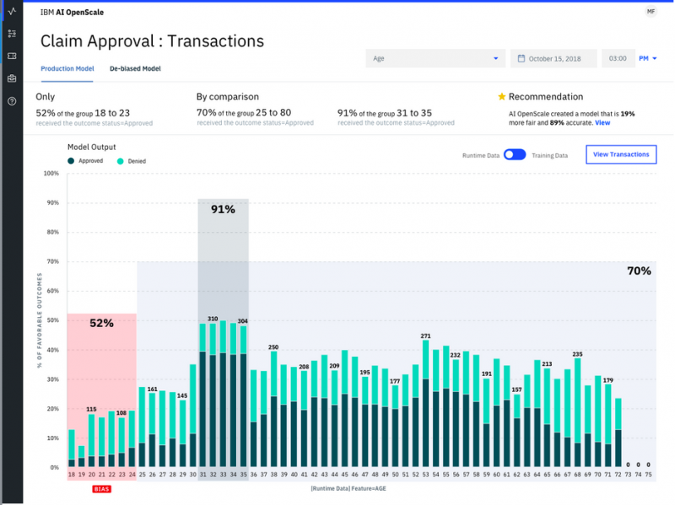

IBM Watson OpenScale
IBM Watson OpenScale uses the same
Open Source components on top of
Kubernetes, Kubeflow and KFServing
Did you know?
<number>
Model Monitoring and visualization of bias (IBM Watson OpenScale)

Slide 20





Component creation
and cataloging...
*.r
[ref]
*.ipynb
*.py
*.sh
C³
MLX
Acumos AI
...using Elyra and ML Exchange (MLX)
Watson Studio Pipelines
<number>
<number>

Slide 21
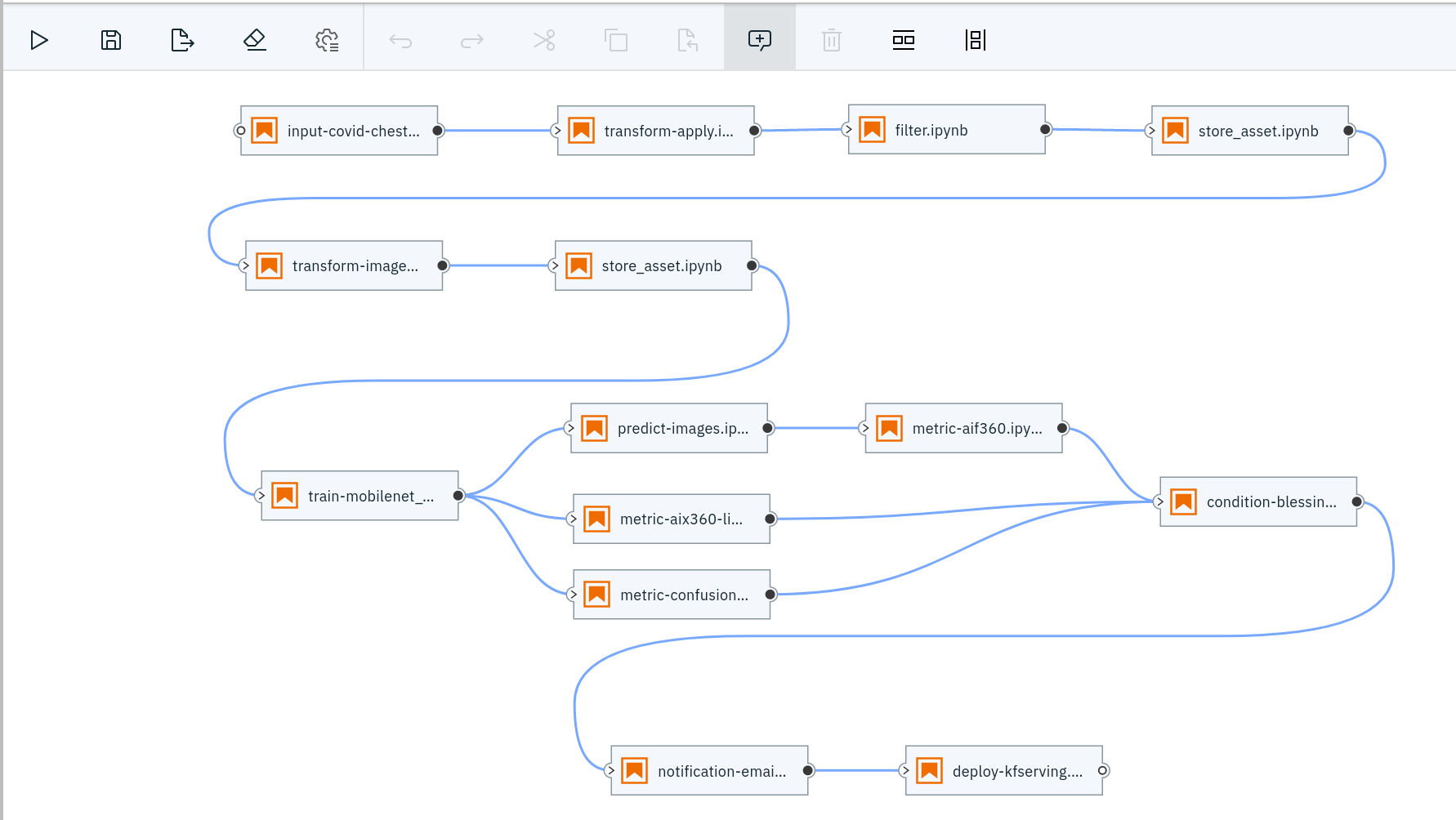
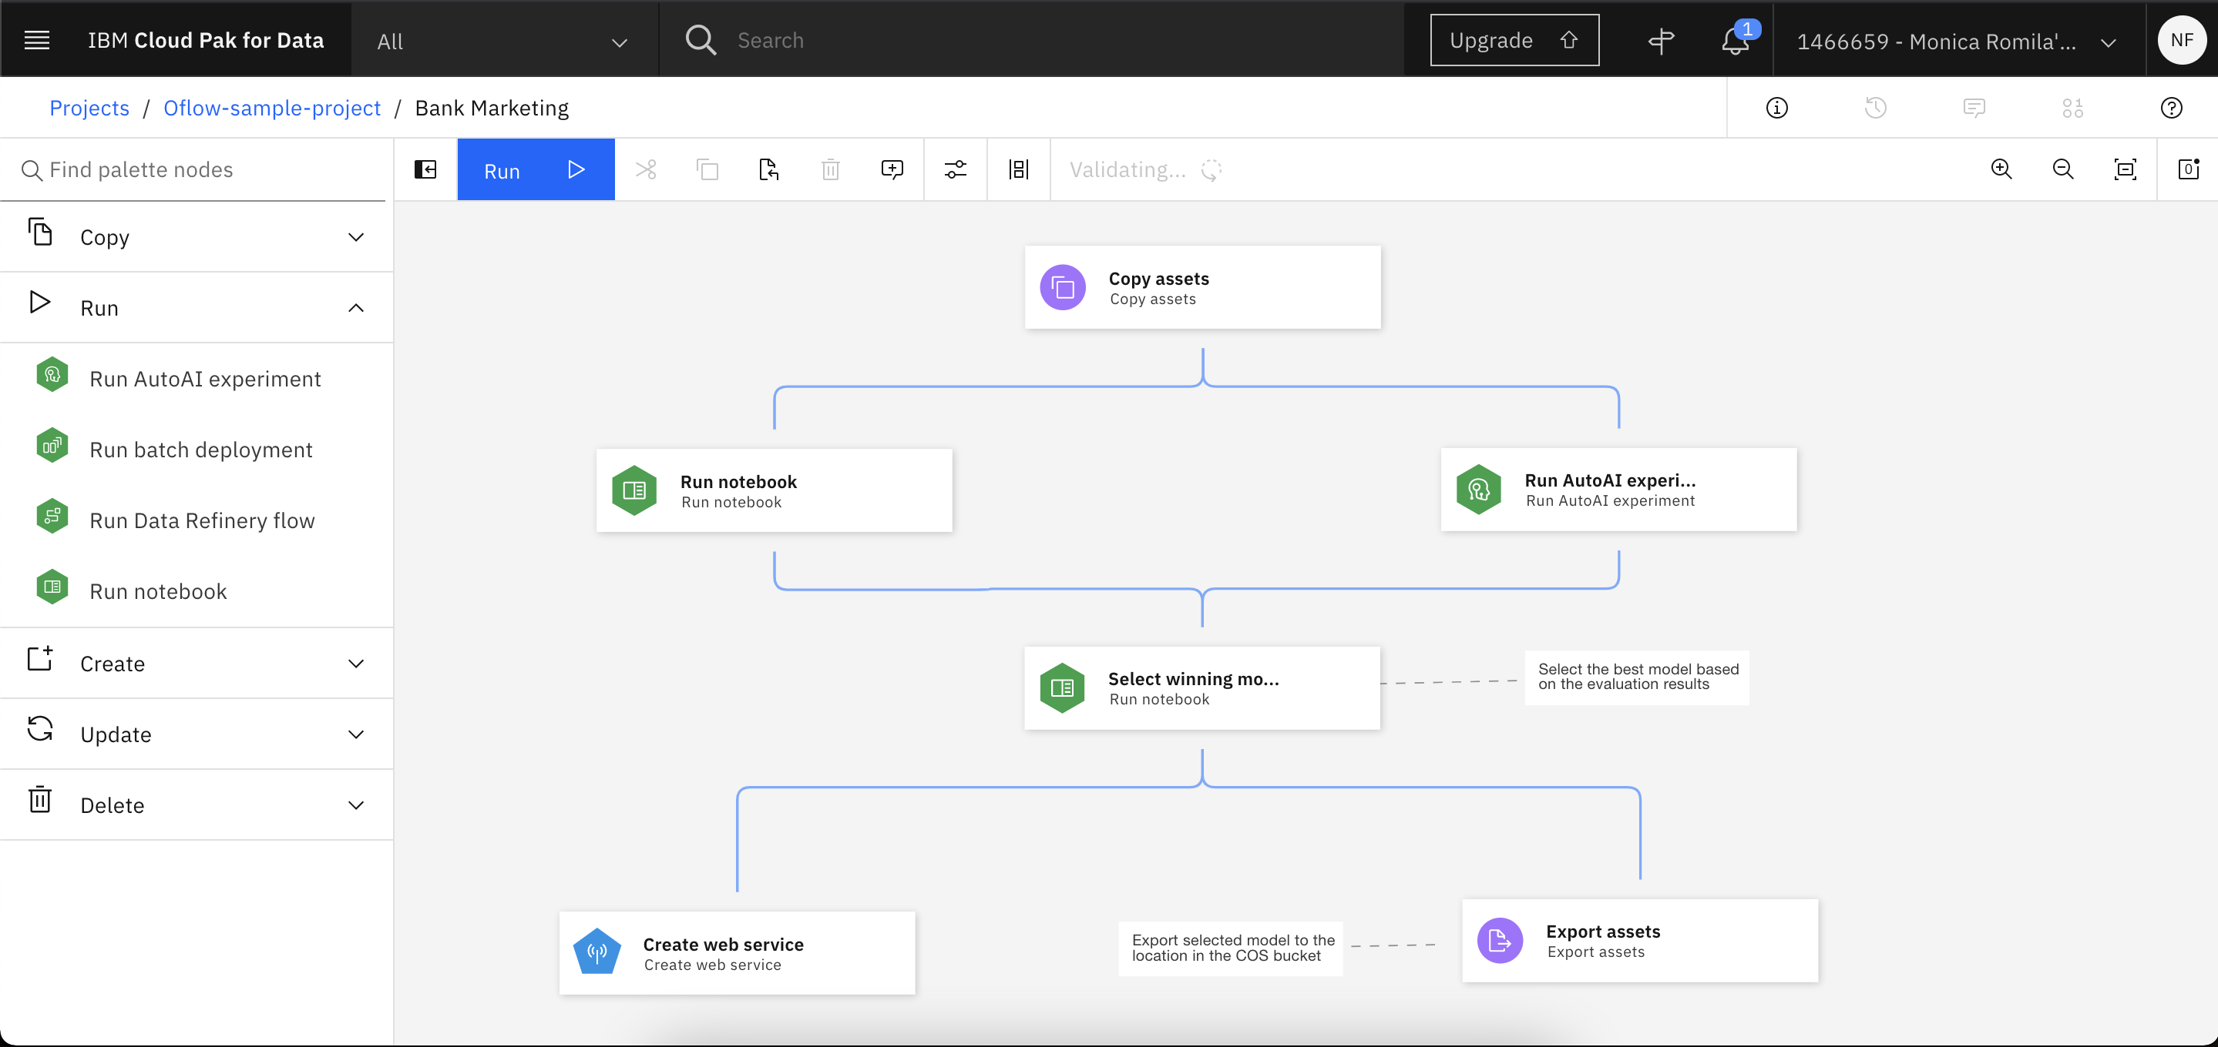
Component
consumption...
...using Elyra or Watson Studio Pipelines
<number>
<number>

Slide 22
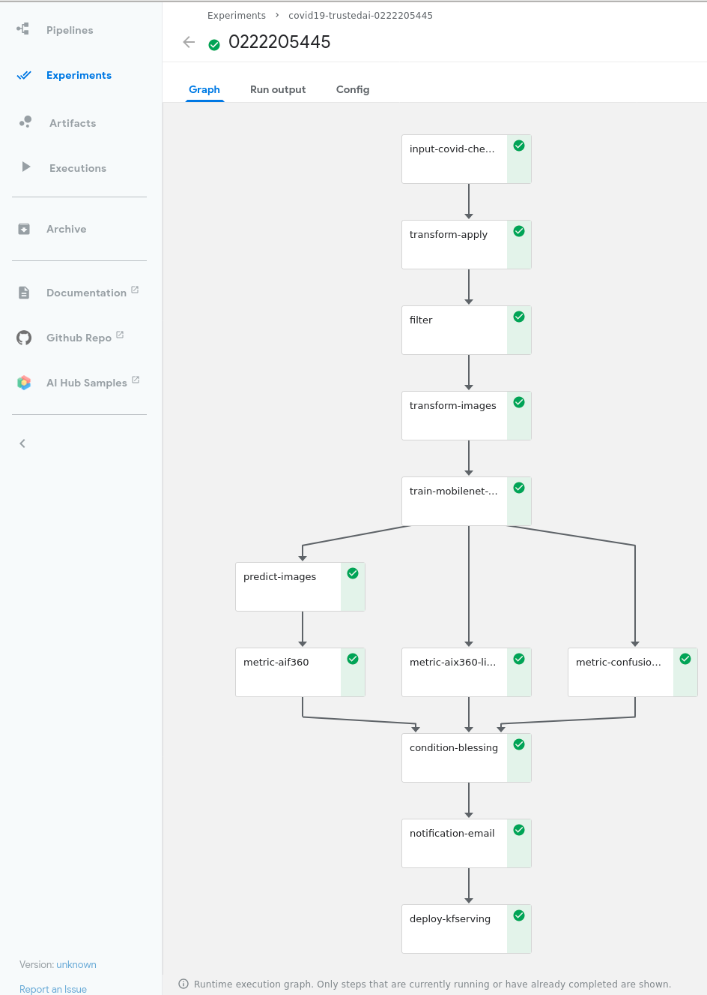
The final pipeline in Elyra..
…and KubeFlow
<number>
<number>

Slide 23

Summary
- Rapid prototyping using visual editing and notebooks
- Seamless scaling during development and deployment
- GPU support
- ML tools: PyData stack, TensorFlow, PyTorch, …
- life science tools: DICOM input, DICOM output, …
- Reproducibility
- Data lineage
- Reference implementation in open source - Collaboration support
<number>

